Slide 1
Consideration of a Vocation to Priesthood and RELIGIOUS life among Never-married U.S. Catholics --CARA Survey Report Rev. JOHN GUTHRIE, S.T.L. ASSOCIATE director USCCB Secretariat of Clergy, consecrated life & vocations
October 2012
ANSH

Slide 2
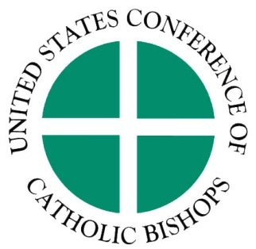
funding
Notes:
USCCB Secretariat of Clergy, Consecrated Life and Vocations & the Secretariat of Cultural Diversity in the Church
The Conrad N. Hilton Foundation

Slide 3
Powerpoint available ONLINE:
http://www.usccb.org/beliefs-and-teachings/vocations/priesthood/
priestly-life-and-ministry/
(FOR WI-FI HERE OR ACCESS LATER)
Notes:
OR go to USCCB.org, go to bottom, click on Clergy, Consecrated Life and Vocations
Left Bar … “Priestly Life and Ministry”
“ANSH 2012 Presentation”

Slide 4
FULL REPORT ONLINE:
http://www.usccb.org/beliefs-and-teachings/
vocations/survey-of-youth-
and-young-adults-on-vocations.cfm
Notes:
Available on Tuesday, October 9.
OR Go to usccb.org, top “Beliefs and Teachings,” then “Vocations”, will be on the right side.

Slide 5
CONTEXT FOR OUR DISCUSSION
Encuentro y misión #45: “La promoción de vocaciones al sacerdocio, al diaconado, y a la vida consagrada deberá ser parte integral de los esfuerzos del ministerio hispano.”
Notes:
From Encuentro and Mission (2002): “The promotion of vocations to the priesthood, diaconate, and consecrated life must be integral to the efforts of Hispanic ministry.”

Slide 6
FURTHER CONTEXT
Bishop Daniel Flores’ Talk on Hispanic Vocations at ANSH, October 2008:
“We ought to try to create the culture of vocations.”
“The language of vocation should be taught and
understood”
“Latin American cultures maintain a strong focus on
the primacy of the word spoken by persons of trust”
“The participation of Spanish-speaking priests who have roots in the culture is vital”
Notes:
“Culture of vocations”/”language of vocations::
One focus is on the immigrant community who are primarily Spanish-speaking.
Another focus (which this study highlights) is to non-immigrant bilingual or English-speaking youth and young adults.

Slide 7
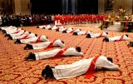
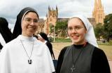
Why this survey?
Annual Surveys of the
Newly Ordained
Annual Surveys of Perpetually Professed
Notes:
CCLV Commissioned CARA to perform this special study as a result of our 15 years of annual surveys of newly ordained and two years of newly, perpetually professed religious. Both surveys indicate a lower number of Hispanic / Latino ordinandi and perpetually professed from year to year

Slide 8
Annual Surveys of New Priests (2012) /Religious (2011)
2012 2011 National
Caucasian / White
71% 66% 58%
Hispanic / Latino
15% 10% 34%
Asian / Pacific Islander
9% 17% 4%
African / African American
3% 4% 3%
Notes:
Consistent underrepresentation of Hispanic / Latino(a) vocations.
2012 column refers to the ordination class of 2012; the 2011 column refers to the statistics from 2011 profession class of women religious. The “national” column refers to the general population of U.S. Catholics.

Slide 9
Country of Birth of Ordinands
United States 71%
Vietnam 5%
Columbia 5%
Mexico 4%
Poland 3%
Philippines 2%
El Salvador 1%
Other 9%
Total Hispanics / Latinos: 15%
U.S. Born Hispanics / Latinos:
<5%
Notes:
The distribution of foreign-born ordinandi may surprise some. It shows that immigrant Hispanics / Latinos (Columbia represented more than Mexico, and Vietnam more than either) are making it into the priesthood in the United States; it is with the U.S. born Hispanics / Latinos (sometimes referred to as “English-speaking or bi-lingual Hispanics/Latinos”) that we see a severe decline in the number of ordinands. “Many Catholics fail to see that collectively Latinos neither rapidly assimilate nor indefinitely retain the Spanish language and their allegiance to Hispanic cultural ways.” (Timothy Matovina, “Latino Catholicism: Transformation in America’s Largest Church, p. 46).
“In the process of adapting to life in the U.S. milieu, many Hispanics lose substantially their connections to their ancestors’ homeland and their Spanish language ability. Despite misconceptions about the Hispanic population exacerbated in recent public debates about immigration, the majority of Latinos in the United States—nearly 70 percent, according to preliminary date for the 2010 census—are not immigrants. A 2003 study revealed that while 60 percent of Hispanics above age 35 are immigrants, only 13 percent of those below age twenty are…among Latino Catholics of high school age, 15 percent primarily speak Spanish, 60 percent are bilingual, and 25 percent speak English with little or no Spanish. Though more than half of Latino adults speak exclusively or primarily Spanish in their home, 2/3 of Latino teens speak exclusively or primarily English among their friends…an analysis of Latino Catholicism that solely emphasizes immigrants and ethnic solidarity is woefully inadequate” (Ibid, p. 57).

Slide 10
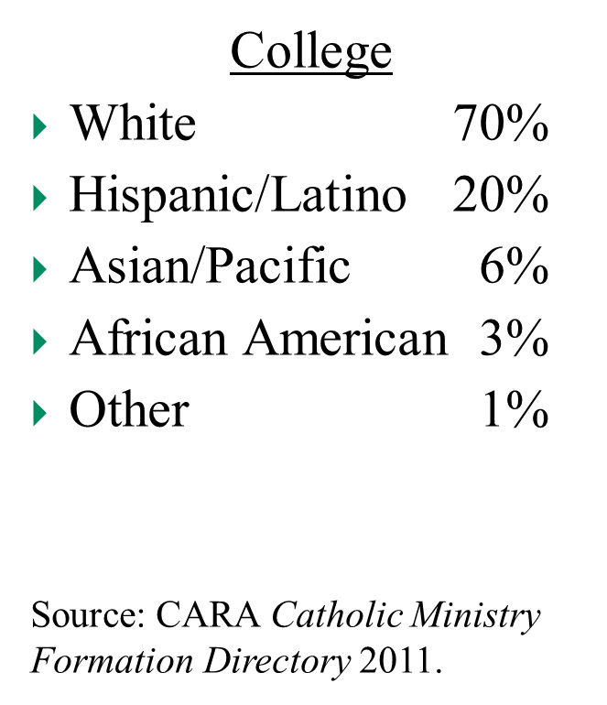
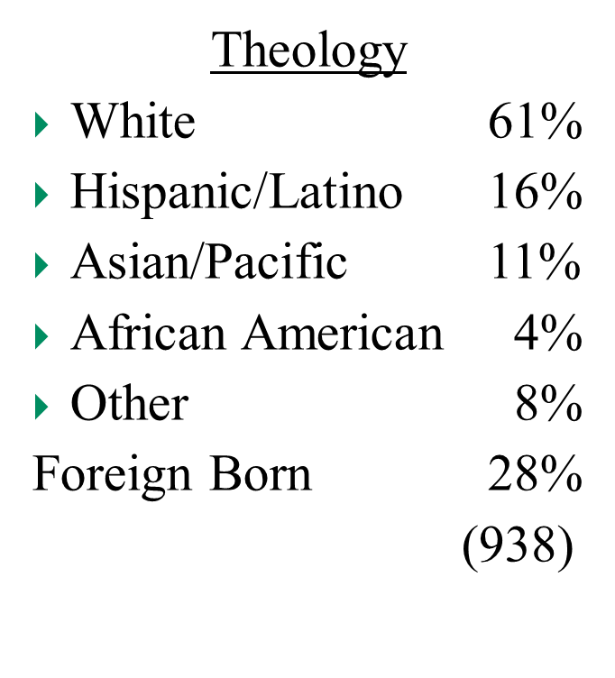
Future Ordination Classes (Seminarians 2011)
Notes:
From the data of seminary enrollments, we see that the ordination classes will become increasingly more diverse; note, however, the underrepresentation of Hispanic seminarians. Unless we can solve the challenges of promoting vocations among English-speaking Hispanic youth, we may witness a precipitous decline in the overall number of Hispanic vocations in the near future—and consequently, an overall drop in the total number of seminarians and ordinations.

Slide 11
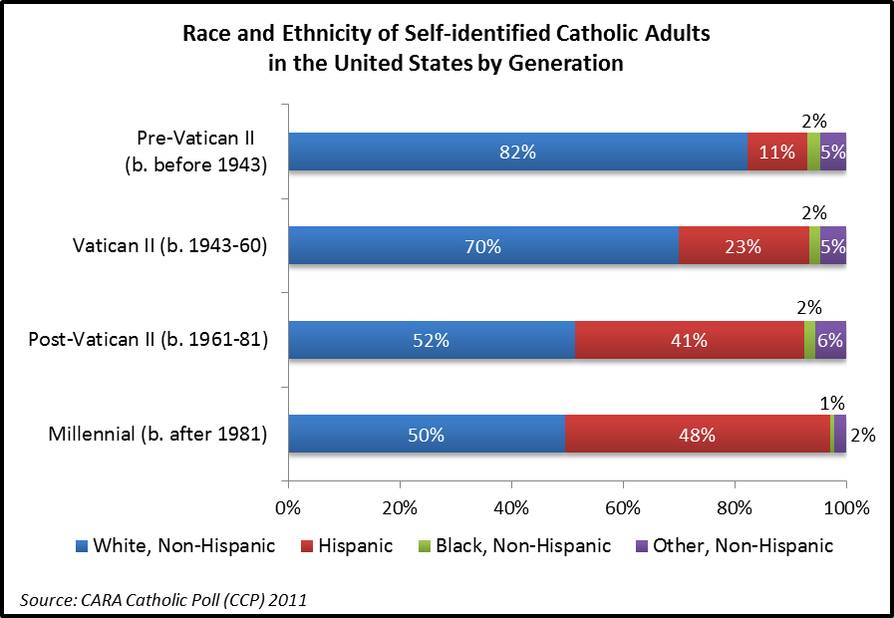
Percentage of Hispanics by generation
Notes:
Note that nearly half of all Catholic youth (31 years of age and under) are Hispanic!

Slide 12
Vocation survey Characteristics
Self-administered, national online survey, conducted in May and June 2012
Scientific, probability-based sample of 1,428 never-married Catholics ages 14 and older
Males (average age 26):
Six in ten are adults (18 or older)
36% Non-Hispanic white adults, 20% non-Hispanic white teens
19% Hispanic adults, 16% Hispanic teens
4% Other race adults, 5% other race teens
Females (average age 28):
Seven in ten are adults (18 or older)
40% Non-Hispanic white adults, 15% non-Hispanic white teens
22% Hispanic adults, 13% Hispanic teens
7% Other race adults, 3% other race teens
Notes:
Every year, CCLV has conducted surveys of those who make it through a program of formation for either the priesthood or religious life. This survey of Catholic, unmarried youth and young adults, however, aims to find out what is going on at the beginning of the “vocation process.”

Slide 13
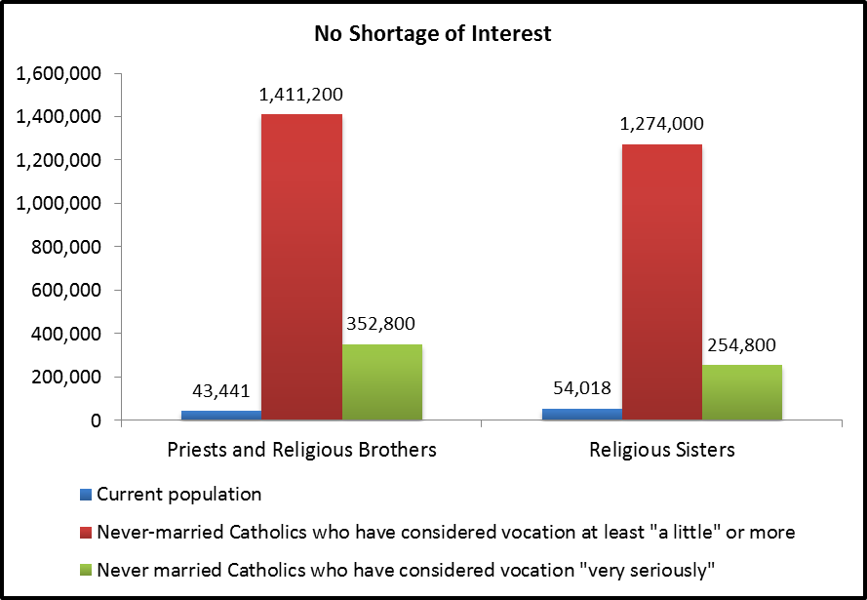
Notes:
Extrapolating from the survey sample, close to a million and a half never-married Catholic men have considered a vocation, and more than 350,000 have considered it very seriously. Similarly, 1.3 million never-married Catholic women have considered a vocation and more than a quarter million of them have considered it very seriously. 3% of men and 2% of women responded that they “very seriously” considered a vocation. The purpose of the report is to help us get a handle on some of the obstacles facing youth and young adults to pursuing a vocation.

Slide 14
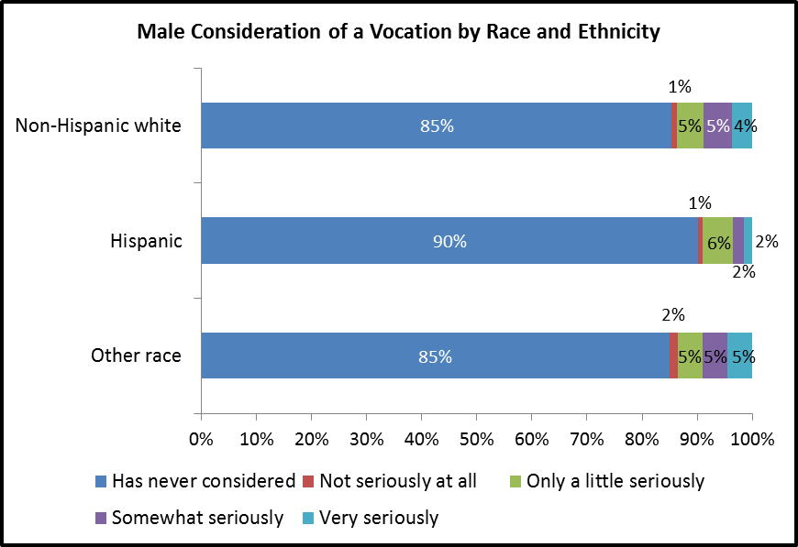
Notes:
Ethnicity is not a significant factor in the consideration of a vocation. Hispanic respondents, both male and female, are nearly just as likely than others to say they have considered a vocation. Nevertheless, nine in ten never-married Hispanic males and more than eight in ten non-Hispanic males say they have never considered a vocation. Furthermore, among the “very seriously” and “somewhat seriously,” there is a precipitous drop off in Hispanic responses.
Age is also not a significant factor, for either men or women.

Slide 15
Notes:
When we asked these men to tell us, in their own words, why they have never considered a vocation, four in ten cite a general lack of interest. Non-Hispanic whites are less likely than others to cite a general lack of interest. About one in five cite celibacy as the reason (no difference by race/ethnicity), and a tenth or fewer cite some other reason – again, no differences by race/ethnicity. What may be surprising to note is that the clergy sex abuse scandal is not a factor in the consideration of a vocation.

Slide 16
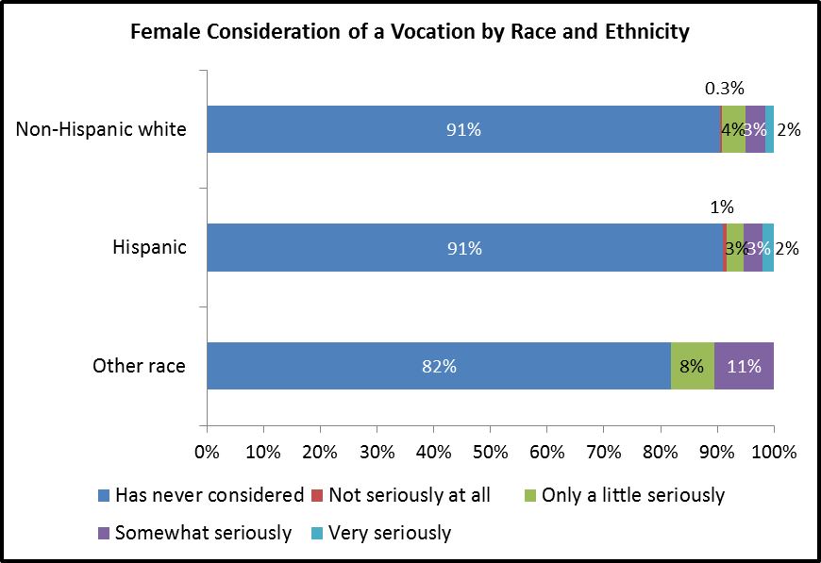
Notes:
As noted, Hispanic females are no less likely than non-Hispanic females to have considered a vocation. Other race females are slightly more likely to have considered a vocation.

Slide 17
Notes:
When we asked them to tell us, in their own words, why they have never considered a vocation, three in ten women cite a general lack of interest. One in seven or less cite celibacy as a reason and one in ten or less cite any other reason.

Slide 18
Key subgroups most likely to have considered a vocation
Most important:
Those who attended Catholic educational institutions at any level
Those who were encouraged to consider a vocation by any type of person
Those who personally know priests and men and women religious
Those involved in parish youth and young adult groups
Notes:
Subgroups of respondents are compared to their likelihood of considering a vocation at least “a little seriously” versus those who do not. Overall, 12% of males and 10% of females say they considered becoming a priest, brother or religious sister at least “a little seriously.” Where percentages of these subgroups are significantly higher than 12 and 10 percent, once can say there is an association between being in this subgroup and greater consideration of a vocation. However, interpretations of causality must be cautioned for two reasons:
1) Correlation does not equal causation. For example, some one who prays the rosary may be more likely to consider a vocation. But is it this activity that caused the consideration of a vocation? Probably not. Instead, there is likely some third factor (e.g., religiosity) that leads the individual to both say the rosary and consider a vocation.
2) Some of these subgroups include small numbers of individuals and even though many in the group may consider a vocation; this may represent very few people in the survey—and in the real population. For example, 38 percent of male respondents who have been to a World Youth Day say they have considered a vocation. However, only 7 percent of male respondents have participated in a World Youth Day (thus 2.6 percent of all male respondents participated in a World Youth Day AND have considered with some seriousness becoming a priest or religious brother).
After controlling for 39 different factors, four primary factors stand out. [Point them out here and then show subgroup differences on subsequent slides]
Catholic schooling
Men who attended Catholic high school are more than 6 times as likely as those who did not, to consider a vocation
Women who attended Catholic elementary school are more than 3 times as likely as those who did not to consider religious life
Encouragement
Men and women who had someone encourage them are twice as likely as those who did not.
Each additional person adds to the effect: respondents who had 3 persons who encouraged them are 5 times more likely to consider a vocation
Knowing someone
Men who personally know a priest, religious, or seminarian are more than 1.5 times more likely to consider a vocation. This is also additive.
Parish youth groups
Men who participated during elementary school are more than 5 times as likely to consider a vocation. Women who participated in a high school youth group are more than 9 times as likely to consider a vocation.
I would like to focus a little more intensively on the first two subgroups: Catholic education and encouragement.

Slide 19
Subgroup: Catholic Education
Minority student enrollment in Catholic schools has been hit hard by the recession. In 2005-06 NCEA reported that 27% of students in U.S. Catholic schools were something other than Non-Hispanic white. This dropped to 19% in the 2011-12 school year (currently 14% of students are Hispanic).
Notes:
Remember, men who attended Catholic high school are more than 6 times as likely to consider a vocation; women who attended Catholic elementary school are more than 3 times as likely
But, two in three respondents overall had no Catholic schooling.
Three in four Hispanic teens and 8 in 10 Hispanic adults have never attended Catholic schools. Not only do Hispanics enroll less in Catholic Schools, their tenure while in Catholic schools is less (p. 24). Similarly, Hispanic involvement in parish-based religious education is comparable to others, but their total years in religious education is less (p. 26).
This effect has been worsened by the recession and by recent immigration policy (read slide).

Slide 20
Subgroup: Encouragement (male)
Notes:
Remember, men who had someone encourage them are almost twice as likely as those who did not to have considered a vocation.
Non-Hispanic white men are more likely to have been encouraged by a priest
Hispanics are more likely to have been encouraged by a family member (other than a parent or grandparent)
Other race men are more likely to have been encouraged by a grandmother

Slide 21
Subgroup: encouragement (female)
Notes:
Remember, women who had someone encourage them are twice as likely as those who did not to consider a vocation.
Non-Hispanic white women are most likely to have been encouraged by a sister or a priest
Hispanic women are most likely to have been encouraged by a teacher, family member, or a sister
Non-Hispanic other race women are most likely to have been encouraged by a priest or chaplain, teacher, or grandmother. We will see on another slide that this group is also more likely to have participated in Catholic campus ministry.

Slide 22
Other Key subgroups
Also Important:
Weekly Mass attenders (now and in high school)
Those who lived in households where parents talked to them about religion at least once a week
Participants in prayer and devotional activities, groups, or programs (e.g., Bible study, Eucharistic adoration, retreats, and prayer groups)
Those belonging to a group that encourages devotion to Mary
Those who regularly read the Bible or pray with Scripture
Participants in World Youth Day or a National Catholic Youth Conference
Notes:
Many of the subgroup differences in consideration of a vocation are related to participation in group, activities, and personal relationships. Surprisingly, there are few subgroup differences related to matter of belief (such as belief in the Real Presence or beliefs about one’s relationship with God).
These activities are also positively related to consideration of a vocation, but for most of these the relationship is not statistically significant.

Slide 23
Hispanic Cultural Opportunities
Institutionally they are less connected to the Church
However, Latinos have some unique cultural supports for religious participation.
While Hispanics are no different than others in regular Mass attendance, they are much more likely to participate in prayer and devotional practices in the home, and to attend Marian feast day Masses.
Spiritual talk at home rates higher among Latina respondents, particularly during high school.
Higher participation rates in World Youth Day, and higher participation in NCYC for Hispanic adults.
Notes:
Latinos are less institutionally connected (lower rates of parish registration, p. 40, and less participation in parish ministries, p. 42), for “the epicenter of Hispanic Catholicism and Hispanic Catholic ministries is the home and extended family” (Matovina, p. 101). Thus, they have cultural supports for religion that other ethnic groups do not. For example, their prayer and devotional practices (p. 41) are significantly higher (pp. 51-52, 54, 55); there is a much higher level of discussion of religious things among Latina females within their families during high school years than with other ethnic groups (p. 35). Hispanics are more likely to attend WYD and, for Hispanic adults, NCYC (p. 44).

Slide 24
A KEY CHALLENGE: Level of Education
Notes:
The number of Latino/a-s who can respond to the call to ministry within current ecclesial structures and actually succeed is very small. The biggest barrier to Hispanic may be the education requirements.

Slide 25
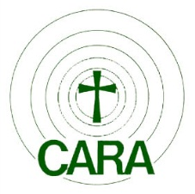
United States conference of catholic bishops Secretariat of Clergy, Consecrated Life and Vocations USCCB.org/Vocations email: cclv@usccb.org Center for applied research in the apostolate cara.georgetown.edu email: cara@georgetown.edu
For further information

